Slide 1

KWARA STATE UNIVERSITY, MALETE FACULTY OF ENGINEERING AND TECHNOLOGY
IMPROVEMENT ON THE DEVELOPMENT OF DISTRIBUTION TRANSFORMER ANTI-VANDALISM SYSTEM.
SUPERVISED BY DR. LAMBE M. ADESINA By: Victor Seun Oluwadamisi. 19/67EC/00922 Emmanuel Opeyemi Alo. 19/67EC/00865
Ayomiposi Praise Ademakinwa 20D/67EC/01055 March,2024.

Slide 2
PRESENTATION OUTLINE
Abstract.
Introduction.
Problem Statement.
Aim & Objectives.
Review of Related Workdone/Literature Review.
Methodology.
Components pricing estimate.
Gantt chart.
Conclusion.

Slide 3
Abstract
Electricity is crucial in our daily lives, with transformers playing a key role in power distribution. However, increasing vandalism against transformers poses challenges for distribution companies, leading to financial losses and power disruptions. To address this, an innovative system is being developed. It integrates advanced technologies like microcontrollers(ESP32), cameras, microwave sensors, and GSM modules to detect and prevent vandalism efficiently. The system aims to safeguard transformers, ensuring the integrity of the global electrical grid.
Keywords: Transformer vandalism, real-time communication, ESP32, camera, alarm, GSM module, microwave sensor.

Slide 4
Introduction
The escalating trend of transformer vandalism presents a significant financial burden on electricity distribution companies, necessitating frequent replacements of stolen components and causing extensive disruptions in power supply for consumers.
In response, our project proposes an innovative surveillance and anti-vandalism system integrating advanced technologies such as a microcontroller, camera, microwave sensor, and GSM module.
Various literatures on similar project were reviewed to establish the gap which serves as our areas of concentration in this research
This comprehensive solution aims to detect and deter potential vandals in real-time, enabling prompt intervention to prevent damage and theft, while emphasizing cost-effectiveness.

Slide 5
Problem statement
1. Loss of revenue for power utility companies.
2. Disruption of business activities.
3. Increased risk of robbery, endangering lives and properties.
4. Reduced productivity attributed to power outages.

Slide 6
Aim & Objectives
AIM: The aim of this project is to further improve on the design and construction of a distribution transformer substation anti vandalism system and control. Using KWASU 500kva library transformer as a case study.
OBJECTIVES:
1. Design an effective transformer vandalism detection system.
2. Conduct review on existing literatures to identify research gaps and possible limitation breakthrough.
3. Construct a responsive system using advanced components that detects and deters transformer vandals promptly.
4. Conduct extensive testing and validation of system for optimal performance of the system.

Slide 7
Review of Related Works/Literature Review
S/N | Author | Title | Strengths | Weaknesses | Gap
1 | Erick Kithinji et al (2017) | Design and Implementation of a Transformer Vandalism Monitoring System | Uninterrupted power supply for the system | Substandard components like PIR sensor which is susceptible to heat | Lack of real world testing statistics
2 | Mary Ahuna et al (2020) | Real-time Transformer Vandalism Detection by Application of Tuned Hyper Parameter Deep Learning Model | Its use of machine learning for real-time surveillance | Limited outdoor deployment results, potential weather-related challenges | No long term reliability due to health depreciation from harsh weather conditions
3 | Sajidur Rahman et al (2017) | Design and Implementation of Real Time Transformer Health Monitoring System Using GSM Technology | Cost effective method and early issue detection | Lack of technical details and doesn't evaluate effectiveness with real-world data or trials. | Expansion of monitored parameters like moisture and dissolved gas in oil

Slide 8
S/N | Author | Title | Strengths | Weaknesses | Gap
4 | Amol A. Sonune et al (2020) | Condition Monitoring of Distribution Transformer using IOT | Real time data monitoring and simplicity using ESP32 and Wi-Fi and Bluetooth | Complete dependency on Wi-Fi which can reduce communication distance | Investigation into Alternative Communication Protocols:

Slide 9
After analyzing previous research on anti-vandalism measures for transformers, we identified three common limitations:
No prevention measure: We prioritize prevention over cure by integrating alarms into the system to deter vandals before they can act.
Sensor inaccuracy: To enhance sensor accuracy, we've adopted advanced microwave sensors known for their precision and durability in outdoor settings.
Security and Environmental Risks: Vulnerabilities in components can expose systems to various environmental and security threats.
Our project addresses these by leveraging modern sensor tech, robust power management, and enhanced security measures.

Slide 10
Methodology.
The design proposes an innovative surveillance and anti-vandalism system integrating advanced technologies such as a microcontroller, camera, microwave sensor, an alarm system and GSM module.
After the system is powered by the installed batteries, the microcontroller, GSM module, alarm system and microwave sensor synergistically function to deter transformer vandalism. The microwave sensor detects heat radiation emitted by potential vandals, promptly signaling the GSM module to alert the nearby security post. Additionally, upon detection of a threat, the surveillance camera is automatically activated to record any movement or disturbance in the vicinity of the sensor, while the alarm triggers to notify people in the neighboring vicinity. These activities are all processed by the ESP 32 micro-controller
This comprehensive solution aims to detect and deter potential vandals in real-time, enabling prompt intervention to prevent damage and theft, while emphasizing cost-effectiveness and mobility for practical deployment in diverse environments.

Slide 11
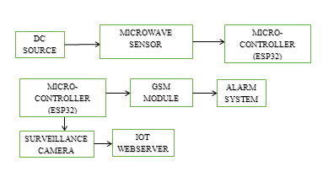
FIG.1 Block diagram

Slide 12
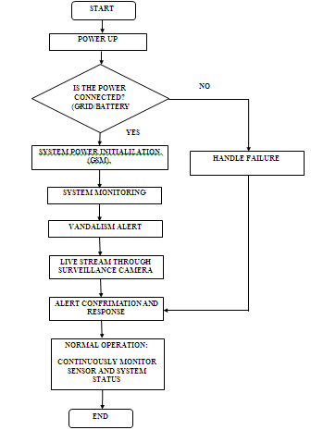
Fig.2 flowchart

Slide 13
Algorithm
Here’s an algorithm for a system incorporating a microwave sensor, surveillance camera, GSM module, ESP32 micro-controller, and an alarm system;
Microwave sensor activation: The microwave sensor emits microwave signals that bounce off objects and return to the sensor. When the sensor detects movement within its range, it sends a signal to the ESP32 micro-controller.
ESP32 micro-controller analysis: The ESP32 micro-controller receives the signal from the sensor and processes it to determine if the movement poses a potential threat. If a threat is identified, the ESP32 micro-controller sends a signal to the GSM module to send an alert message to the user’s phone via SMS or MMS.
Surveillance camera integration: The ESP32 micro-controller also sends a signal to the surveillance camera to start recording. The recorded footage is sent to the ESP32 micro-controller for analysis using machine learning algorithms.
Alarm system activation: Simultaneously, upon threat detection, the alarm system is activated to sound an alert locally through a siren or other audible means.

Slide 14
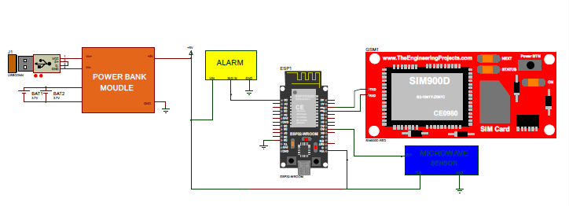
Fig.3 Circuit diagram

Slide 15
Components pricing estimate
S/N | Name of equipment | Quantity | Price(Naira)
1 | Microwave sensor | 1 | 55,000
2 | ESP32 micro-controller | 1 | 30,000
3 | Surveillance camera | 1 | 200,000
4 | GSM module | 1 | 20,000
5 | DC source (18v Solar panel & 3.7v lithium ion cell backup) | 1 | 30,000
6 | Alarm system | 1 | 20,000
 |  |  | Total= 355,000

Slide 16
Gantt chart
S/N | Project activities | Nov | Dec | Jan | Feb | Mar | Apr | May | June | July
1 | Planning
2 | Design & implementation
3 | Coding
4 | Testing
5 | Delivery

Slide 17
Conclusion
We presented the design and implementation of an innovative transformer anti-vandalism system, employing an ESP32 micro-controller to oversee components such as a microwave sensor, an alarm system, surveillance camera, and GSM module. Upon detecting movement from potential vandals, the system promptly activates the GSM module and alarm system to notify the nearby police station, while the camera captures visual evidence.
Our testing methodology involved a comprehensive breakdown, including a detailed flow chart and block diagram of the system. Through this project, we aim to address the shortcomings of existing anti-vandalism systems, providing a more effective and reliable solution for safeguarding transformers against potential threats.

